Slide 1
Eukaryotic Genes and mRNA Processing

Slide 2
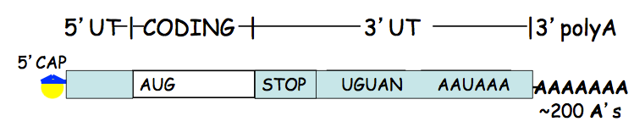
Eukaryotic mRNAs ARE NOT gene replicas
Pre-mRNA transcribed in the nucleus, goes through processing: 1) 5’ cap addition, 2) 3’ cleavage and polyadenylation, and 3) splicing
Transported into the cytoplasm, where translation occurs
5’-UTR: 5’ cap to the start of translation (AUG)
Coding Region: Start of translation (AUG) through multiple codons in open reading frame
3’-UTR: STOP codon and polyadenylation signal sequences, as well as regulatory sequences that control stability, localization, and translation

Slide 3
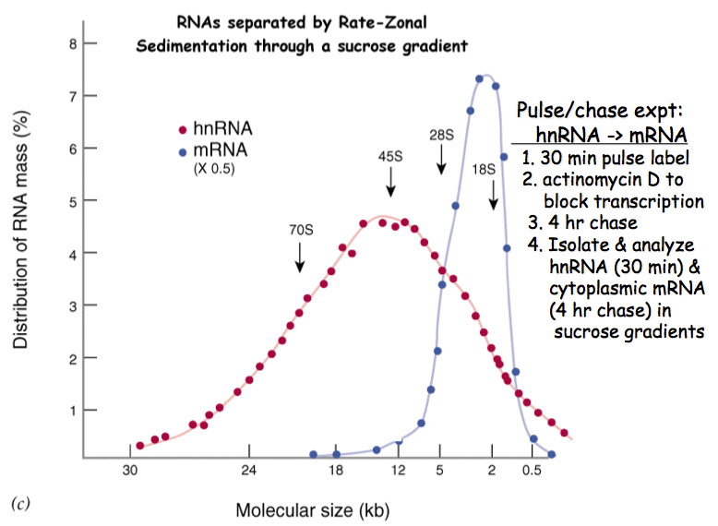
Notes:
Larger precursor RNA synthesized in nucleus (hnRNA)
Processed into shorter mRNA and transported into cytoplasm (mRNA)

Slide 4
mRNA Processing
5’ Cap Addition and 3’ Cleavage and Polyadenylation
http://www.youtube.com/watch?v=YjWuVrzvZYA
mRNA Splicing
http://www.youtube.com/watch?v=FVuAwBGw_pQ
mRNA derived from much larger hnRNA (pre-mRNA)
Processing events occur as the newly transcribed mRNA emerges from RNA polymerase.
hnRNA contains both expressed sequences called exons and internal RNA sequences called introns, introns are removed and exons are joined

Slide 5
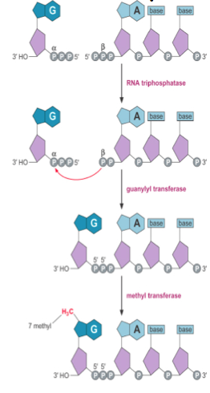
5’ capping occurs immediately after transcription is initiated (about 25-30 nt long)
1) RNA triphosphatase cleaves phosphate group from 5’ end of pre-mRNA
2) Guanylyl transferase: adds guanine to 5’ end of pre-mRNA
3) Methyl transferase: adds methyl group to 7’ carbon of guanine
Unusual 5’-5’ phosphate linkage of the 7’-methyl guanine to the pre-mRNA
The cap binding complex (CBC) binds to completed cap to protect the pre-mRNA from 5’ exonuclease degradation

Slide 6
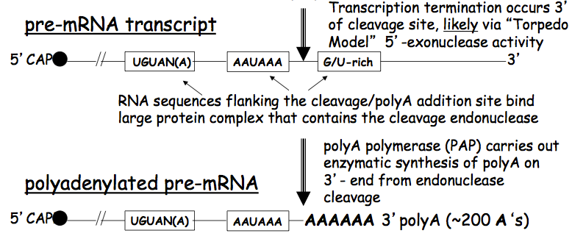
Torpedo model of termination: 5’ to 3’ exonuclease binds and displaces RNA polymerase
3’-end of pre-mRNA cleaved in preparation for polyadenylation
PolyA polymerase (PAP) synthesized an ~200 nt polyA tail
Poly-A binding proteins (PAB) initially bind to a short polyA sequence, which stimulates synthesis of the polyA tail
ALL eukaryotic mRNAs except those that code for histone proteins have polyA tails

Slide 7
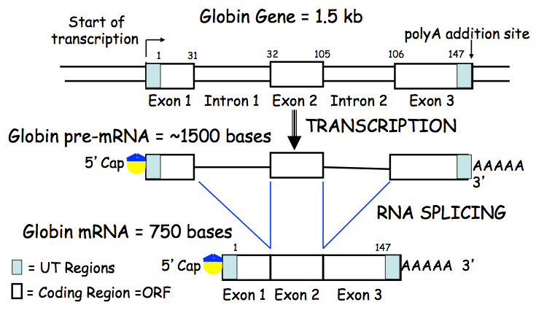
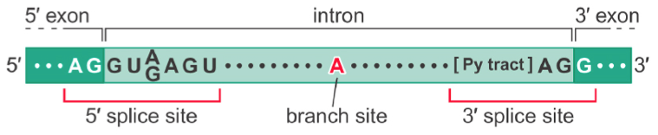
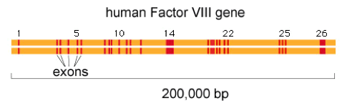
Most eukaryotic genes are composed of several short exon sequences flanked by much longer introns
The average human gene is ~28 kb, with ~9 exons and ~8 introns
mRNA splicing occurs with extreme precision, without adding or removing a single base from the exon sequence
All introns begin with 5’-GU(A/G)AGU, end with a pyrimidine tract (U/C) followed by AG-3’, and contain A at the internal branch site
Notes:
Discovered in the globin gene, pre-mRNA contained sequences that were not present in mature mRNA (called introns)

Slide 8
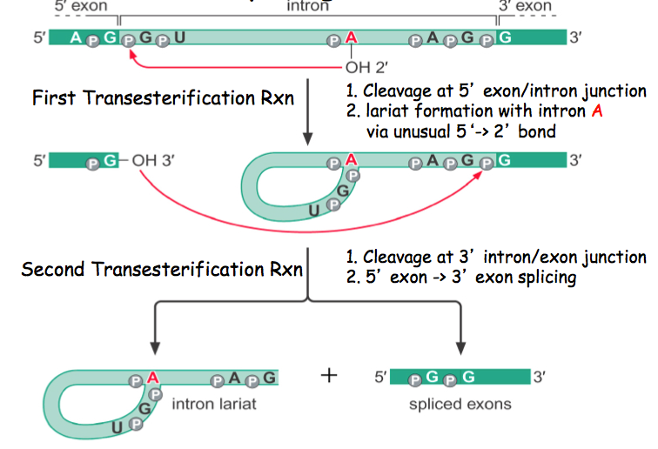
Notes:
Transesterification: alcohol + ester = different alcohol + ester (note that the -OH essentially changes location)

Slide 9
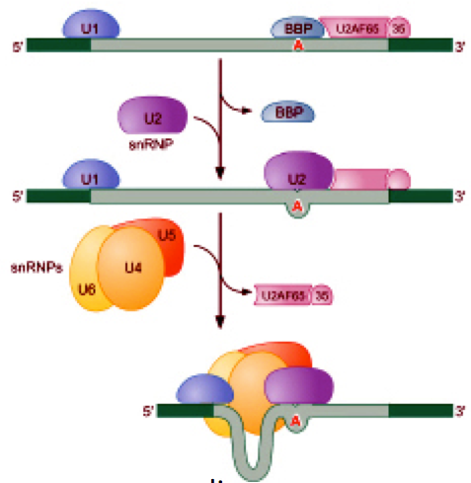
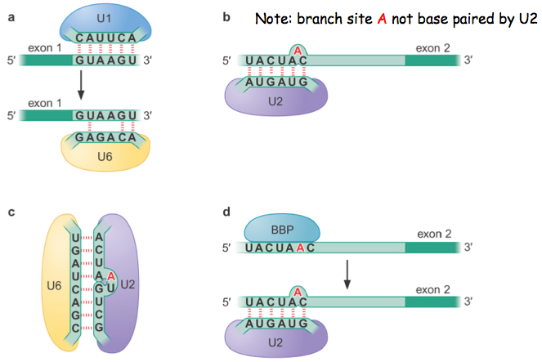
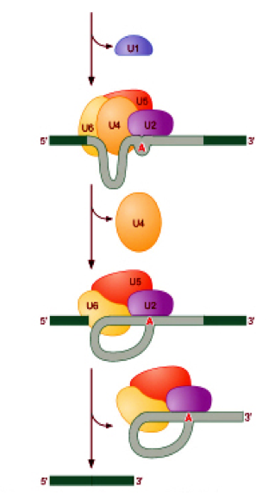
Spliceosome composed of ~150 proteins and 5, uridine-rich, snRNAs (U1, U2, U4, U5, and U6)
U1: binds 5’ splice site
U2: binds A of internal branch site
U4/U5/U6 complex brings 5’ splice site to internal branch site
U6: catalyzes 5’ cleavage and lariat formation
U5: catalyzes 3’ cleavage and joining of exons
Notes:
BBP binds branch point (released for U2 binding)
U2AF65/35 binds 3’ polypyrimidine tract (released for U4/U5/U6 complex binding)
Rearrangement: release of U1, and U4 and base pairing between U6 and U2
U6 catalyzes first reaction, U5 the second
Lariat cleaved by debranching enzyme and degraded

Slide 10
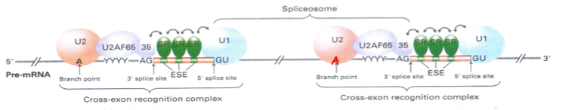
Cross-exon recognition complex (CERC)
Serine/arginine (SR) proteins bind to exon splicing enhancers (ESE) which defines 5’-GU and 3‘AG splice sites (exon definition)
Directs spliceosome assembly
Activators (SR proteins): contain RNA recognition motifs (RRMs) and Ser/Arg-rich regions for protein-protein interactions
Interact with both exonic and intronic splicing enhancers (ESEs, ISEs) and stimulate constitutive and alternative splicing
Remain bound, required for transport
Inhibitors (hnRNP): contain RRMs and Gly-rich regions for protein-protein interactions
Interact with both exonic and intronic splicing surpressors (ESSs, ISSs) and sterically block SR proteins, splicing factors, and spliceosome

Slide 11
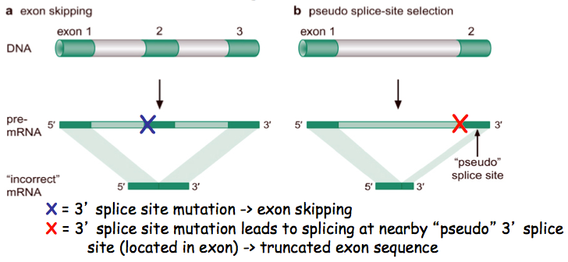

Slide 12
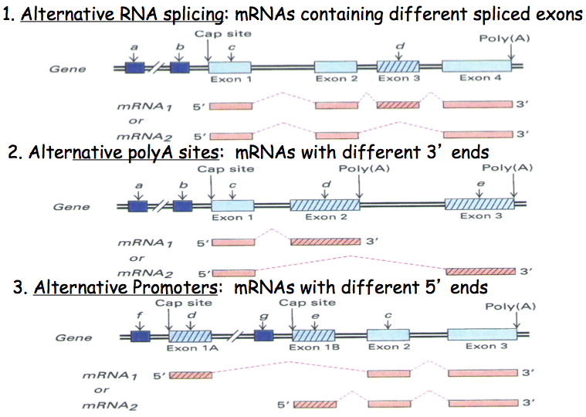
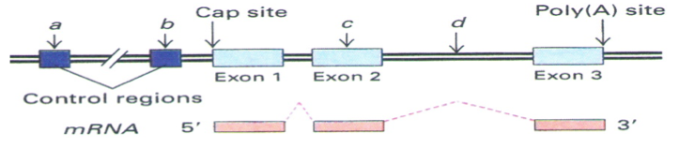
One gene, multiple mRNAs, multiple proteins
Most genes in higher eukaryotes, including humans, are complex transcriptional units
1) Alternative splicing
2) Alternative polyadenylation
3) Alternative promoter
These are often used in combination
One gene, one mRNA, one protein
Only ~5% of human genes are simple transcriptional units (all yeast genes)
RNA splicing is invariant, or constitutive

Slide 13
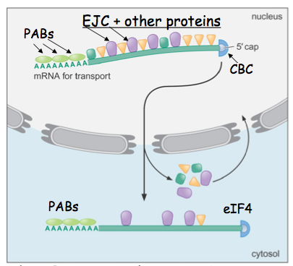
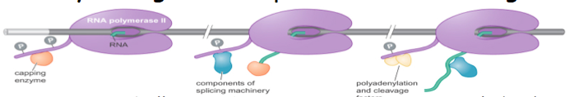
Transcription and mRNA processing are coupled, and the CTD tail of RNA polymerase serves as a platform for all of these steps
5’ cap added immediately after the initiation of transcription (when pre-mRNA is only ~25-30 nt long)
Spliceosome assembled at CTD of RNA polymerase as exons are transcribed and defined (5’ splice sites are usually spliced to adjacent 3’ splice site)
Splicing occurs at a slower rate than transcription, polyadenylation usually occurs before splicing is complete
This defines the exonic content of the mRNA and splicing continues until completion
Exon junction complex (EJC)
PolyA binding complex (PAB)
Cap binding complex (CBC)
mRNA exporter complex uses GTP hydrolysis to export mature mRNA into the cytoplasm where CBC is replaced by eIF4 and EJC and PAB are recycled

Slide 14
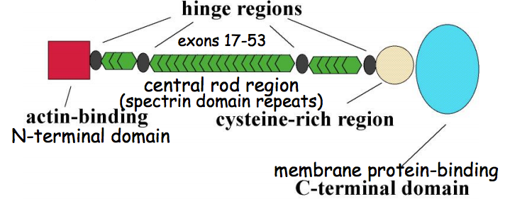
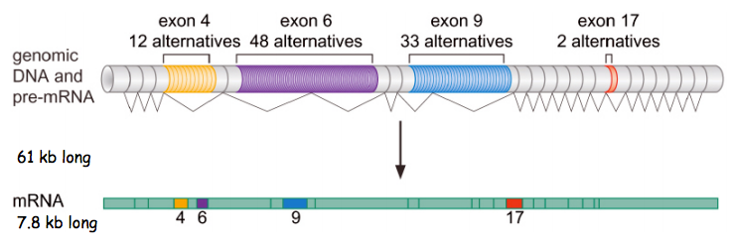
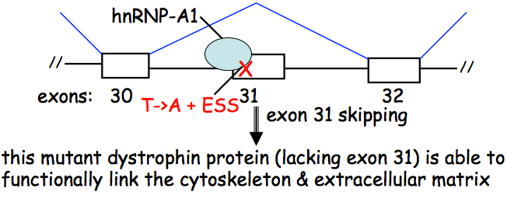
Drosophila DSCAM
Can produce 38,016 alternatively-splices mRNAs and proteins
This gene is involved in complex eye development
Dystrophin gene (DMD)
T to A point mutations in Exon 31 leads to leads to a STOP codon, and creates a new ESS site that binds hnRNP-A1, which causes Exon 31 skipping

Slide 15
The Genetic Code and Transfer RNA (tRNA)

Slide 16
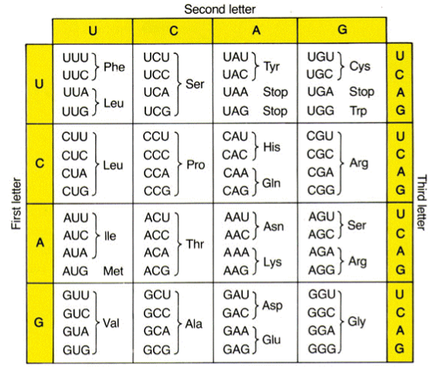
Genetic and biochemical studies established the three base code for amino acids
60 codons code for 20 amino acids, with 3 STOP signals
The genetic code is degenerate, meaning that more than one codon codes for a single amino acid (except Met and Trp)
Mutations in first position give rise to similar amino acids, mutations in second position that maintain purines or pyrimidines give rise to similar amino acids, and mutations in the third position rarely change the amino acid

Slide 17
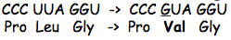
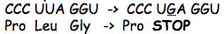
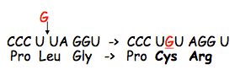
Silent Mutation
One codon changed to another codon that codes for the same amino acid
Does not change the protein sequence
CCC UUA GGU -> CCA UUA GGU
Pro Leu Gly -> Pro Leu Gly
Missense Mutation
One codon changed to another that codes for a different amino acid
Changes a single amino acid
Nonsense Mutation
One amino acid coding codon changed to a STOP codon
Premature termination of translation
Frameshift Mutation
Insertion of one or two bases that changes or “shifts” the ORF
Changes the remainder of the protein sequence

Slide 18
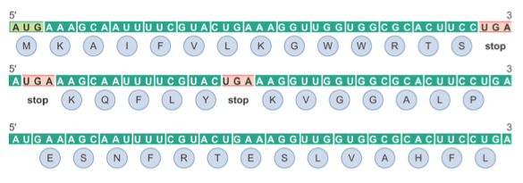
Codons are read 5’ to 3’
Codons are non-overlapping, there are no gaps between codons
Translated in a fixed reading frame set by a START codon (AUG, which encodes Met)

Slide 19
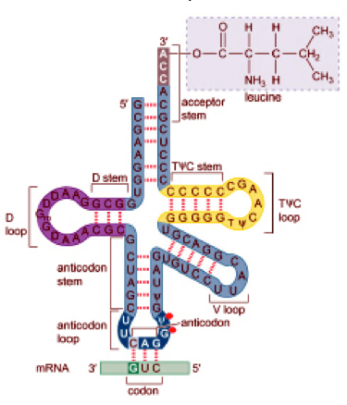
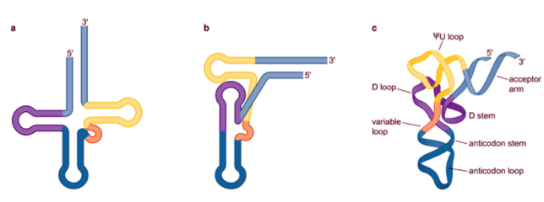
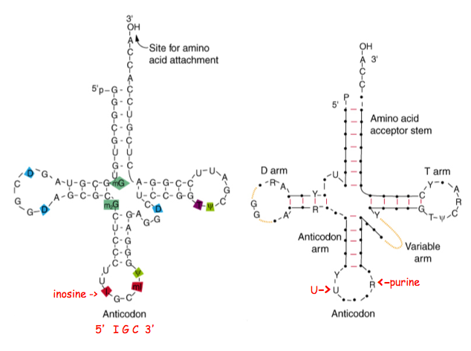
Transfer RNA (tRNA) is an adaptor molecule in translation
Reads mRNA codons and delivers the correct amino acid to the ribosome
70-80 nt long, folded into well-established and similar secondary and tertiary structures
Transcribed as larger precursors
CCA at exposed 3’-end of tRNA molecule enzymatically added, rather than transcribed
Anticodon region base pairs with mRNA codon, and correct amino acid attached to 3’-end at CCA

Slide 20
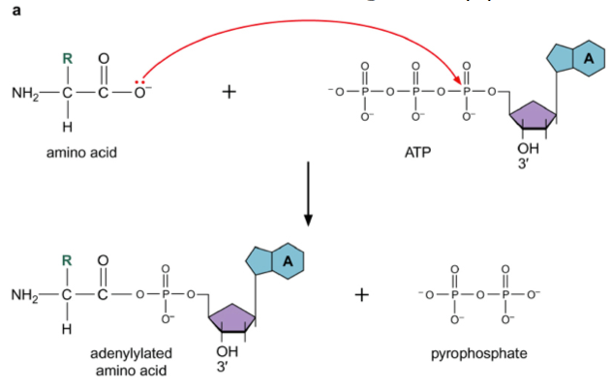
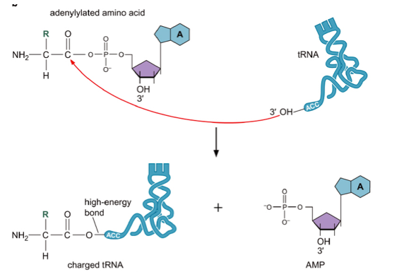
tRNA synthetase catalyzes the reaction that attaches the amino acid to the 3’-CCA-OH
tRNA molecules with different anticodons that code for the same amino acid (isoaccepting tRNAs) are charged by the same synthetase (one synthetase for each of the 20 amino acids)
Acceptor stem, discriminator base (fourth base from 3’-end), and anticodon loop recognized by synthetase
These are the only regions that contribute to differences in three-dimensional structure
1) ATP + amino acid --> amino acyl-AMP + pyrophosphate
2) amino acyl-AMP + tRNA --> amino acyl-tRNA + AMP
Notes:
Accuracy of protein synthesis dependent on tRNA synthetase recognition of specific amino acids and their correct tRNA (ribosome does not possess proofreading activity)

Slide 21
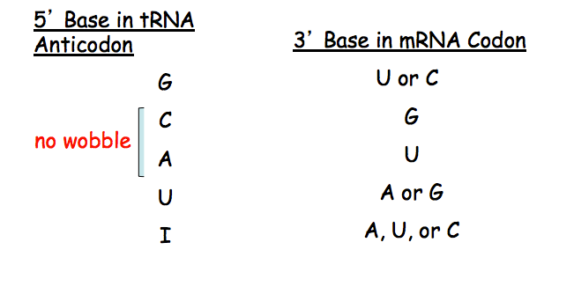
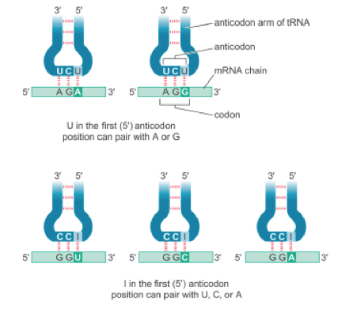
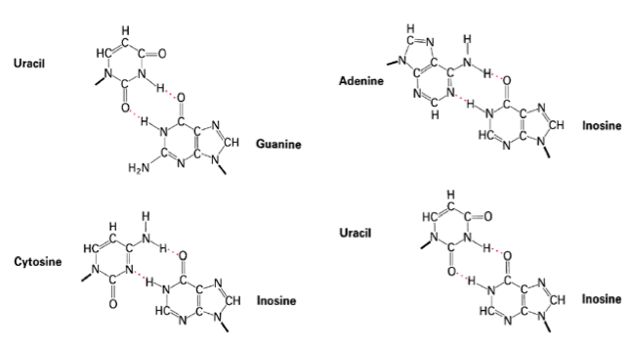
A single tRNA must recognize multiple codons, allowed for by unusual pairing between the third (3’) base of the mRNA codon and first (5’) base of the tRNA called “wobble pairing”

Slide 22
Ribosomes and Protein Synthesis

Slide 23
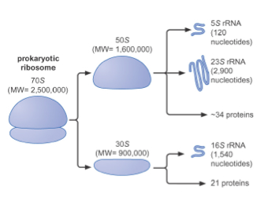
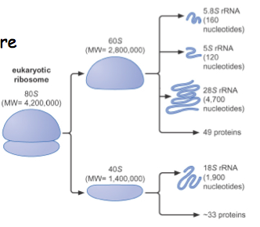
Ribosome is composed of 50% protein and 50% RNA
Eukaryotic 80S ribosome more complex and 40% larger than the prokaryotic 70S ribosome
Prokaryotic 70S ribosome
30S small subunit: contains 16S rRNA which interacts with tRNA anticodons
50S large subunit: contains 23S rRNA which catalyzes peptide bond formation
Eukaryotic 80S ribosome
40S small subunit: contains 18S rRNA
60S large subunit: contains 28S rRNA
(roles analogous to those in prokaryotic ribosome)
Each mRNA translated by multiple ribosomes simultaneously

Slide 24
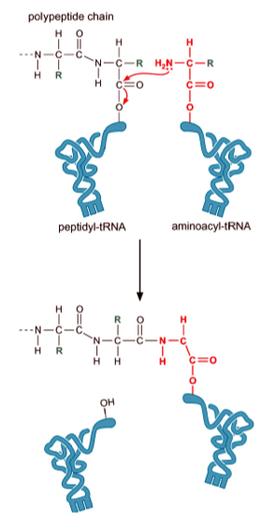
Proteins are synthesized in the N-terminal to C-terminal direction
Substrate: charged tRNA
Reaction: amino terminus of the next amino acid to be added attacks the carboxyl carbon of the growing polypeptide chain
Energy: breaking the “high energy” amino acyl-tRNA bond releases more energy than making the peptide bond takes
Ultimately, the energy comes from the ATP used in the charging reaction

Slide 25
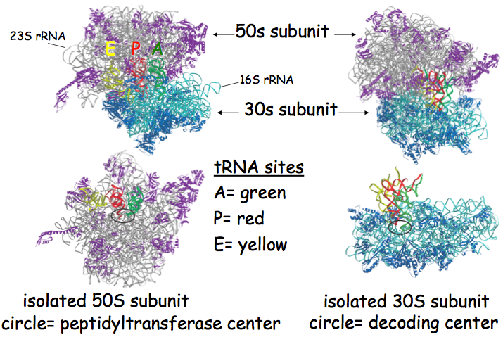
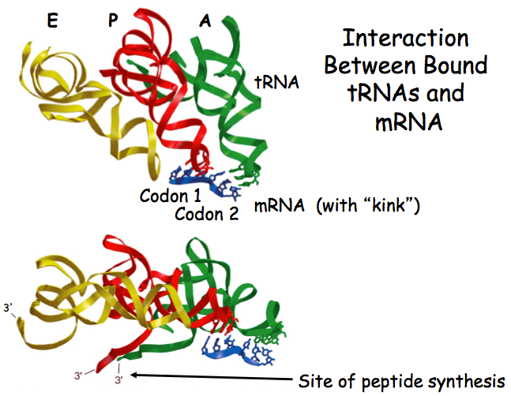
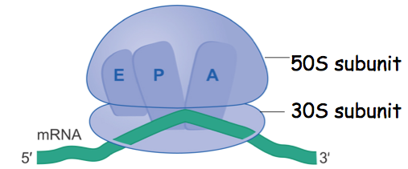
A (“amino acyl-tRNA”) site: amino acyl-tRNA enters this site and interacts with the mRNA codon
P (“peptidyl-tRNA”) site: new peptide bonds are formed at this site with amino acyl-tRNA
E (“exit”) site: transiently occupied by newly uncharged tRNA before leaving the ribosome
tRNA anticodon and mRNA codon interactions occur in both the A and P sites
mRNA “kink” or bend in ribosome facilitates this interaction

Slide 26
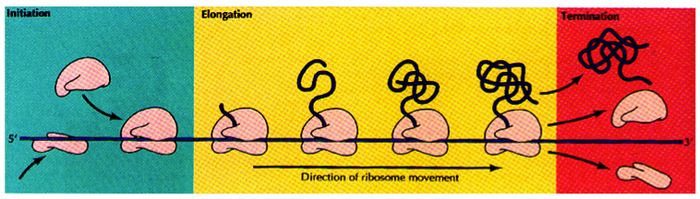
Non-ribosomal proteins are required for all three phases of translation (initiation, elongation, initiation)
Initiation: IF-1, IF-2, IF-3
Elongation: EF-Tu, EF-Ts, EF-G
Termination: RF-1 RF-2, RF-3-GTP
Same function in eukaryotes, but more complex regulation with more factors
GTP hydrolysis required for conformational changes and regulation during translation
ATP hydrolysis required for peptide bond formation (occurs during tRNA charging)
rRNAs carry out majority of catalysis in translation, the proteins mainly serve a structural role
Notes:
Initiation: formation of initiation complex
Elongation: peptide bond formation, translocation
Termination: release of completely polypeptide, dissociation of ribosome

Slide 27
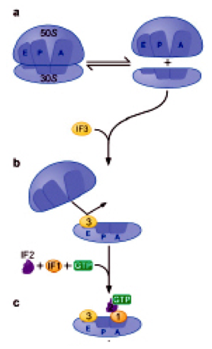
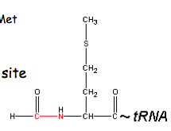
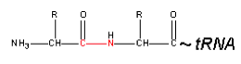
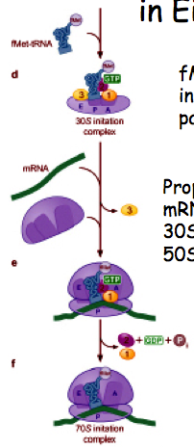
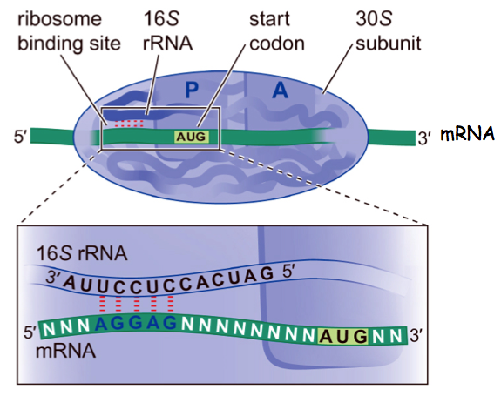
Shine-Delgarno sequence is a ribosome binding site (base pairs with 16S rRNA) 5-10 nucleotides upstream of the mRNA AUG codon
Initiator tRNA (tRNAi^{Met}) modified by the addition of a formyl group (allows binding direction to P site)
IF3: binds E site and blocks re-association of 50S subunit until initiator tRNA is present in P site
IF1: blocks amino acyl-tRNA from entering the A site on the small subunit
IF2: GTPase that interacts with the 30S subunit
(IF interactions leave only P site open to initiator tRNA)
Binding of initiator tRNA forms pre-initiation complex, which causes a conformational change releasing IF3 and allowing re-association of 50S subunit
50S binding causes GTP hydrolysis, releasing IF2 and IF1 forming the complete 70S initiation complex
Notes:
Prokaryotic initiation, presence of formyl group facilitates binding directly to P-site

Slide 28
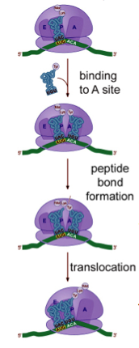
Amino acyl-tRNA binds A site and bases pairs with mRNA codon (assisted by EF-Tu-GTP, GTP hydrolysis and release of EF-Tu-GDP)
Peptide bond formation of elongating chain on the tRNA in the P site to the amino acid on the amino acyl-tRNA in the A site
23S rRNA is a ribozyme that catalyzes peptide bond formation (can catalyze reaction stripped of protein)
1 ATP to charge tRNA
2 GTP, 1 for Ef-Tu delivery of charged tRNA to A site and 1 for EF-G translocation into P site
tRNA in A site moved to P site (“translocation”) driven by EF-G-GTP, GTP hydrolysis and release of EF-G-GDP
These steps are repeated until the STOP codon
STOP codon recognized by release factors (RF), which trigger hydrolysis of polypeptide from tRNA
RF1: recognizes UAG and UAA
RF2: recognizes UGA and UAA
RF3: stimulates release of RF1 and RF2
GTP hydrolysis required for termination
Notes:
In eukaryotes, no formyl group added to Met, translation typically initiates at first AUG after 5’ cap
More factors and more complex, initiation the only step that significantly differs from prokaryotes

Slide 29
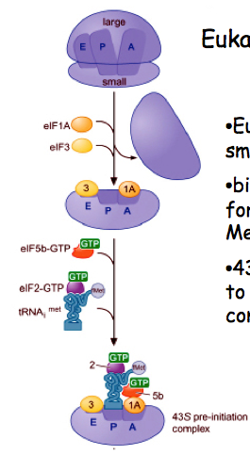
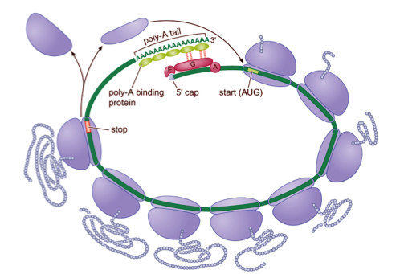
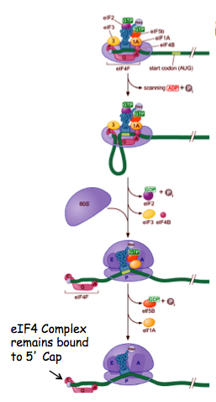
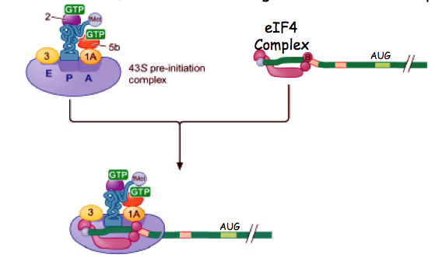
Translation initiates at first AUG after 5’ cap
Initiator tRNA (no formyl group) binds 40S subunit in P site forming the 43S pre-initiation complex
Pre-initiation complex binds eIF4-bound (eIF4F aka “cap binding complex” and eIF4B, helicase that removes secondary structure) mRNA
Pre-initiation complex scans for AUG, at which eIF3 and 1A are released and 60S subunit binds, forming the 80S initiation complex
Elongation and termination similar to prokaryotes (more complex with more factors)
Eukaryotic mRNAs held in circular formation to promote rapid re-initation

